Slide 1
R visualization
import/export data
basic plot and ggplot2

Slide 2
import/export data
#import_data
read.csv(), read.table(), read.excel(), fread() (package data.table), load()
or choose.files(); load(files= )
#export_data
#save R project
save.image(file = "R_objects.RData")
save(x, y, file = "Two_Objects.RData") #export some oject
#save csv file
write.csv(df, "my_df.csv") #phân cách bởi dấu “,” và dấu “.” phân cách thâp phân
write.csv2(df, "my_df.csv") #phân cách bởi dấu “;” và dấu “,” làm phân cách thập phân
#write a table to CSV in R
tb <- table(chickwts$feed)
write.csv(tb, "my_tb.csv")
write.csv2(tb, "my_tb.csv")
#data to R to txt file
df <- trees[1:5, ]
write.table(df, "file.txt")
#excel files
library(xlsx)
write.xlsx(cars, "cars.xlsx")

Slide 3
install.packages(“data.table”) library(data.table)
fread() function
It's simply works
Extremely fast
Improved read.table()
Example
data <- fread('/home/acer/Downloads/dowload/data.tsv', header=T)
https://www.youtube.com/watch?v=opai4Wmp6Zo

Slide 4
Reshape2
install.packages("reshape2")
library(reshape2)

Slide 5
FirstName <- c("Mary", "Mike", "Greg")
age <- c(44, 52, 46)
IQ <- c(160, 95, 110)
people <- data.frame(FirstName, age, IQ)
people
> library(reshape2)
> melted_people <- melt(people, id = "FirstName")
> melted_people
FirstName variable value
1 Mary age 44
2 Mike age 52
3 Greg age 46
4 Mary IQ 160
5 Mike IQ 95
6 Greg IQ 110
FirstName age IQ
1 Mary 44 160
2 Mike 52 95
3 Greg 46 110
> dim(people)
[1] 3 3
> dim(melted_people)
[1] 6 3

Slide 6
Syntax:
melt(data, na.rm = FALSE, value.name = “value”)
Parameters:
data: represents dataset that has to be reshaped
na.rm: if TRUE, removes NA values from dataset
value.name: represents name of variable used to store values
melt.data.frame for data.frames
melt.array for arrays, matrices and tables
melt.list for lists

Slide 7
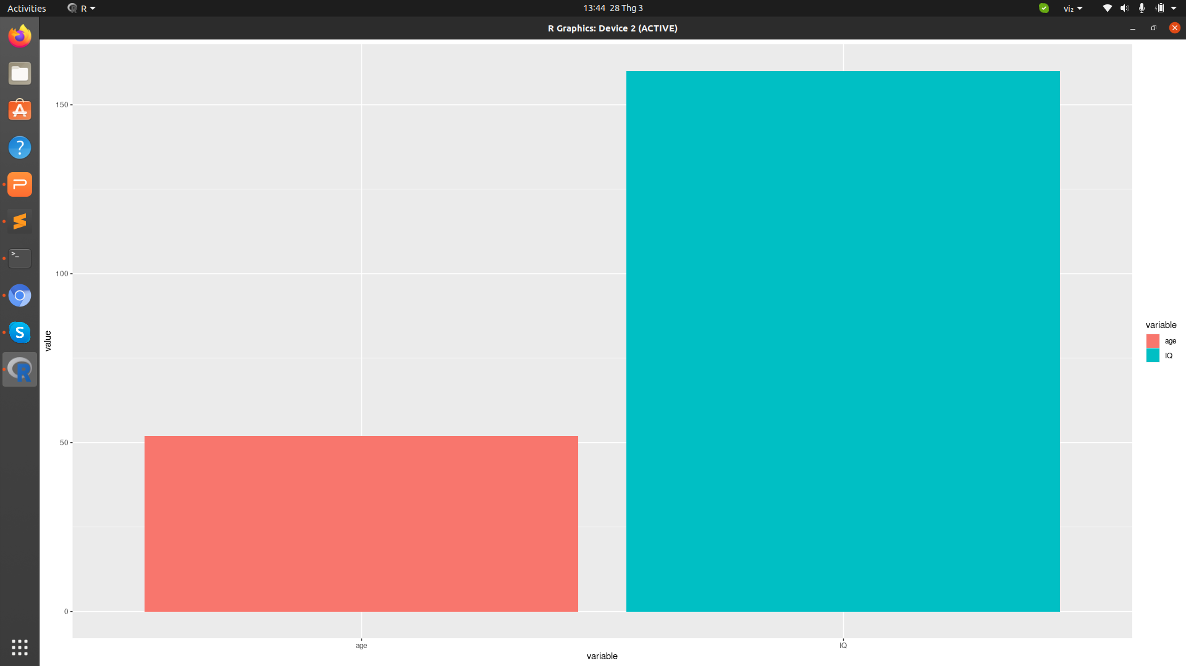
ggplot(data = melted_people , aes(x = variable, y = value, fill = variable)) + geom_col(position = 'dodge')
FirstName variable value
1 Mary age 44
2 Mike age 52
3 Greg age 46
4 Mary IQ 160
5 Mike IQ 95
6 Greg IQ 110

Slide 8

do.call ()
do.call ("any_function", arguments_list)
The do.call R function executes a function by its name and a list of corresponding arguments
This function allows you to call any R function, but instead of writing out the arguments one by one, you can use a list to hold the arguments of the function.
x1 <- 1:10
do.call(“sum”, list(x1))

Slide 9
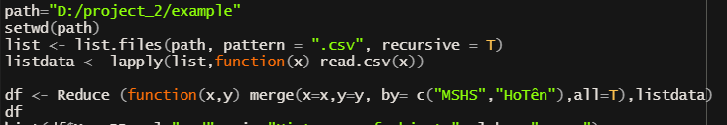
Reduce ()
path="D:/project_2/example"
setwd(path)
# 5 files in list
list <- list.files(path, pattern = ".csv", recursive = T)
listdata <- lapply(list,function(x) read.csv(x))
#Reduce and apply function merge for 2 files for each
df <- Reduce (function(x,y) merge(x=x,y=y, by= c("MSHS","HoTên"),all=T),listdata)
df

Slide 10
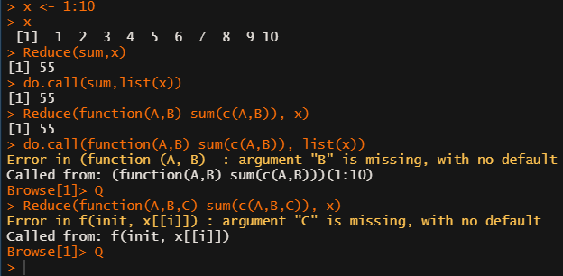
Reduce vs do.call
x <- 1:10
Reduce(sum,x)
do.call(sum,list(x))
Reduce(function(A,B) sum(c(A,B)), x)
do.call(function(A,B) sum(c(A,B)), list(x))
Reduce(function(A,B,C) sum(c(A,B,C)), x)
Do.call | Reduce
apply function for all elements in list | Take 2 elements to apply function for each (only 2 element)

Slide 11
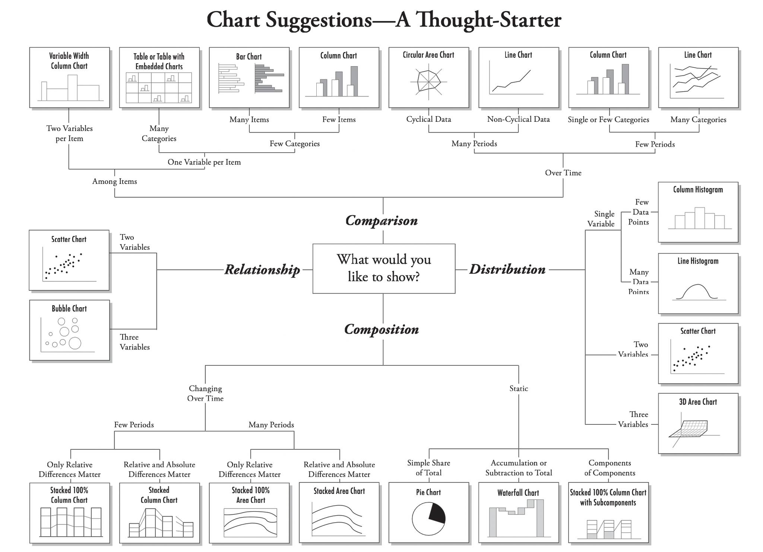
There are four basic presentation types that you can use to present your data:
Data Visualization Best Practices
Comparison
Composition
Distribution
Relationship

Slide 12
basic plot and ggplot2

Slide 13
Packages: ggplot2
library(ggplot2)
ggplot(data, aes(x= ,y= ,fill= )) + A + label + Size
Which A: geom_bar(stat=“identity”)
geom_histogram()
geom_boxplot()
geom_point()
geom_text()
geom_tile()
…
Label:
+ xlab(“ “)
+ ylab(“ “)
+ ggtitle(“ “)
+ xlim(c(from,tt)) +ylim(c(from,tt))
Size:
axis.text=element_text(size= ), axis.title=element_text(size= ), plot.title=element_text(size= ), legend.text=element_text(size= ), legend.title=element_text(size= ),

Slide 14
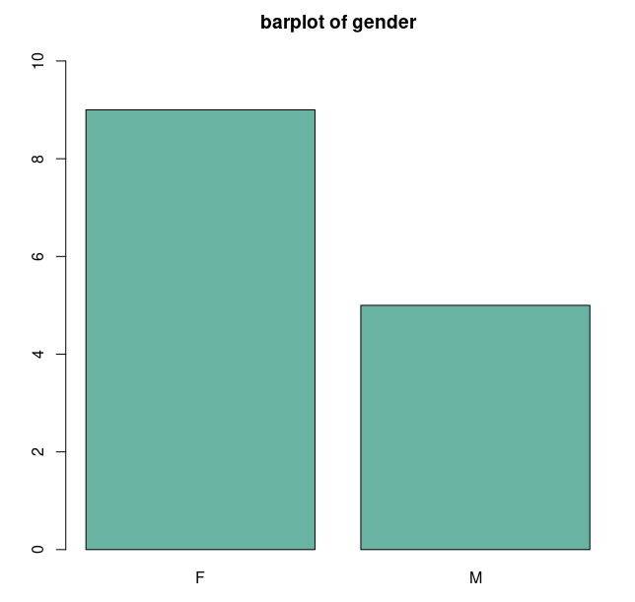
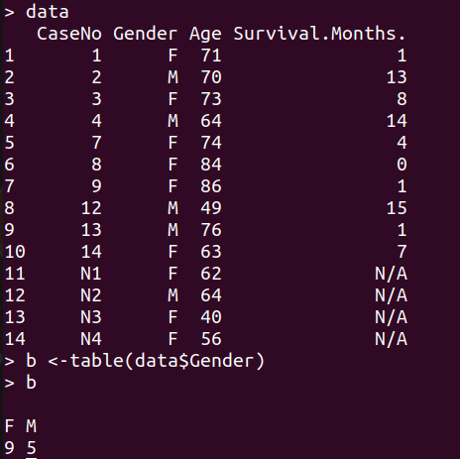
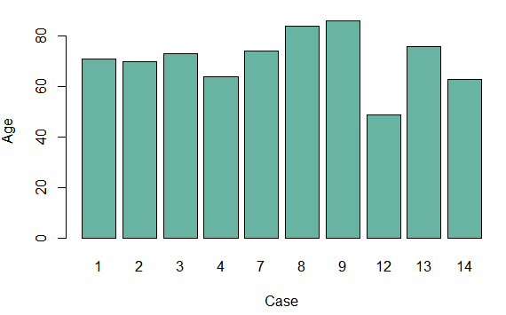
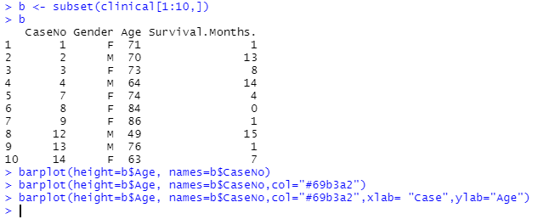
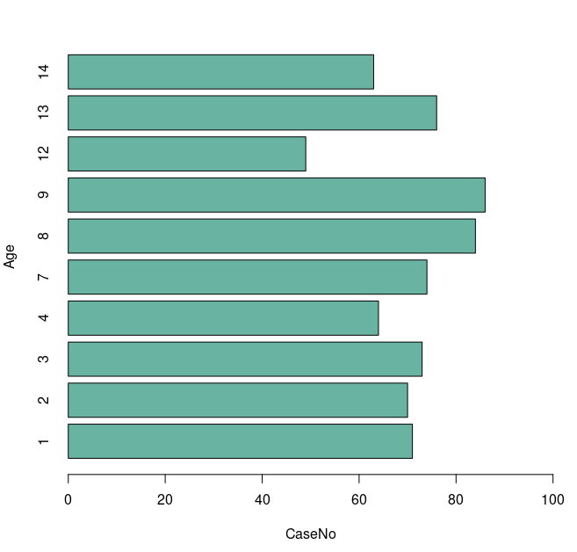
Barplot - basic
data <-read.csv("/home/acer/Documents/DATA/DATA_VISUALIZATION/data/clinical.csv",header=TRUE)
b <- table(data$Gender)
barplot(b,ylim=c(0,10),col="#69b3a2",main="barplot of gender")
b <- subset (data[1:10,])
barplot(height =b$Age, names = b$CaseNo,col="#69b3a2", xlab = "CaseNo", ylab = "Age")
barplot(height =b$Age, names = b$CaseNo,col="#69b3a2", xlab = "CaseNo", ylab = "Age",xlim=c(0,100),horiz=T)

Slide 15
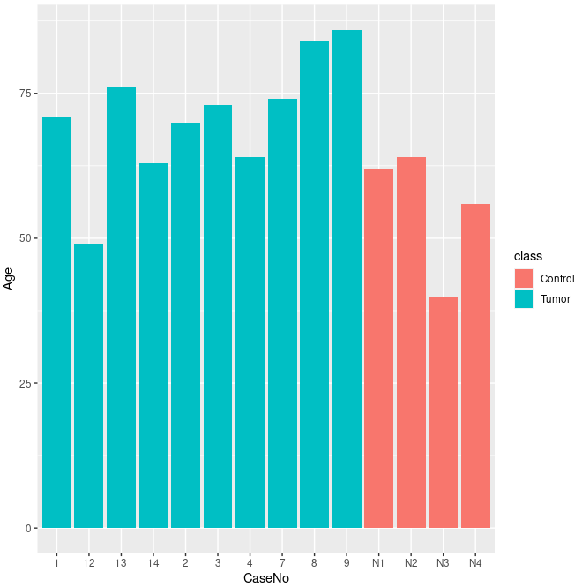
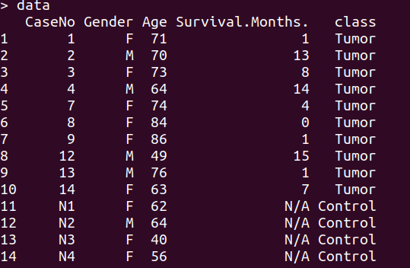
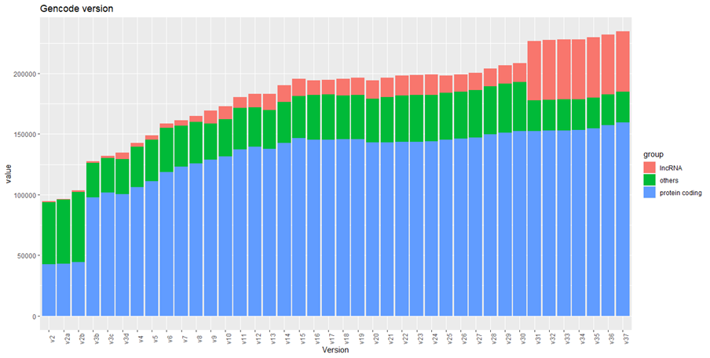
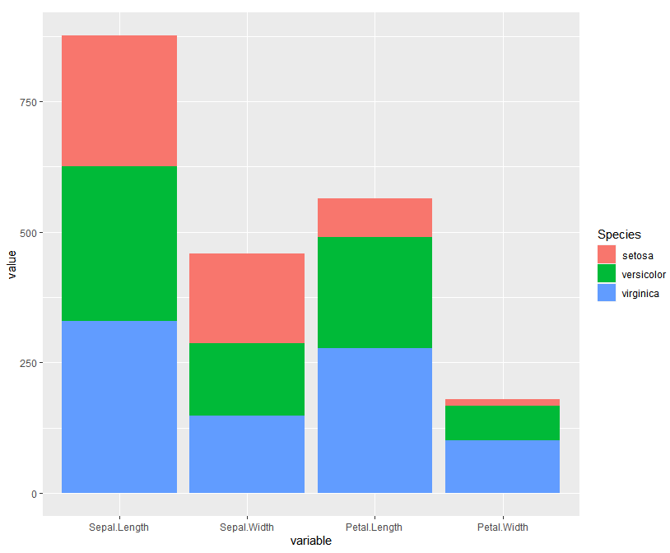
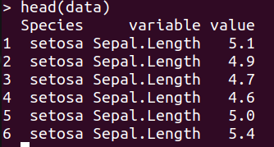
Barplot - ggplot
data$class <- ifelse(data$CaseNo=="N1"|data$CaseNo=="N2"|data$CaseNo=="N3"|data$CaseNo=="N4","Control",”Tumor”)
data$CaseNo <- factor (data$CaseNo, levels=c(1,2,3,4,7,8,9,12,13,14,"N1","N2","N3","N4"))
ggplot(data,aes(y=Age,x=CaseNo,fill=class))+geom_bar(stat="identity")
data <- melt(iris)
head(data)
ggplot(data,aes(x=variable,y=value,fill=Species))+geom_bar(stat="identity")

Slide 16
#gencode version
#R
path="D:/gencode2"
setwd(path)
list.files(path)
list=list.files(path,pattern=".gz.txt",recursive=T)
listdata=lapply(list,function(x) read.table(x,sep="\t",header=T,col.names=c(x,"count")))
head(listdata)
#merge
df <- Reduce(function(x,y) merge(x=x, y=y, by="count",all=T), listdata)
#rename
names(df) <- gsub("gencode.", "" ,names(df))
names(df) <- gsub(".annotation.gtf.*", "" ,names(df))
library(ggplot2)
library(reshape2)
#
data<- melt(df)
library(tidyverse)
data= data %>% mutate(group=ifelse(count=="lncRNA"|count=="lincRNA" | count=="miRNA","lncRNA",ifelse(count=="protein_coding","protein coding","others")))
data$variable <- factor(data$variable, levels=c("v2","v2a","v2b","v3b","v3c","v3d","v4","v5","v6","v7","v8","v9","v10","v11","v12","v13","v14","v15","v16","v17","v18","v19","v20","v21","v22","v23","v24","v25","v26","v27","v28","v29","v30","v31","v32","v33","v34","v35","v36","v37","v38"))
ggplot(data,aes(x=variable,y=value,fill=group))+ geom_bar(position="stack",stat="identity") + xlab("Version")+ ylab("value")+ ggtitle("Gencode version") +theme(axis.text.x = element_text(angle = 90))
#Download
for i in `seq 1 38`
do
wget http://ftp.ebi.ac.uk/pub/databases/gencode/Gencode_human/release_${i}/gencode.v${i}.annotation.gtf.gz
echo ${i}
done
# edit
for i in `find *gtf.gz`
do
zcat $i | tr -d '";'| awk 'OFS="\t" {if ($3=="transcript") print $14}'|sort|uniq -c| awk 'OFS="\t" {print $1,$2}' > ${i}.txt
done

Slide 17
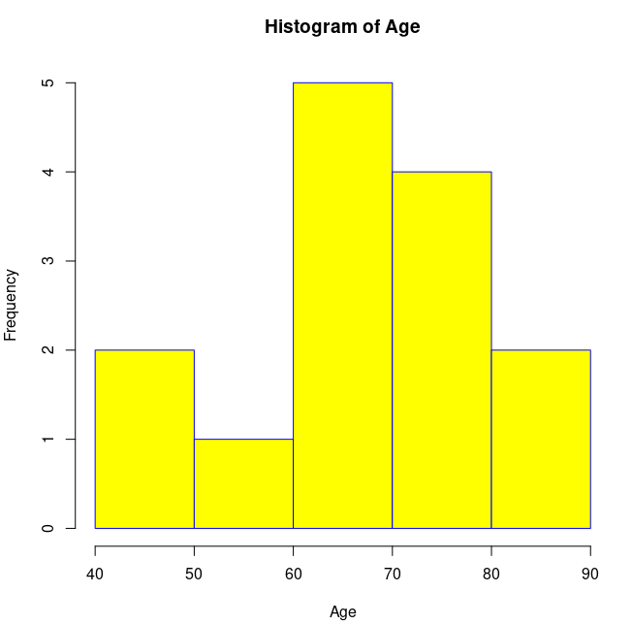
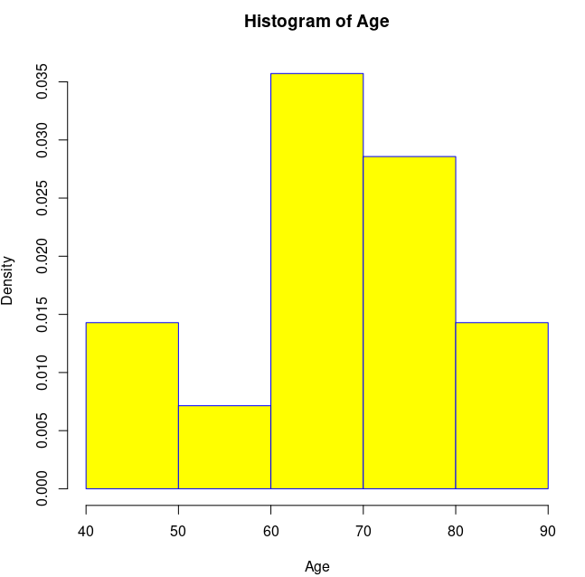
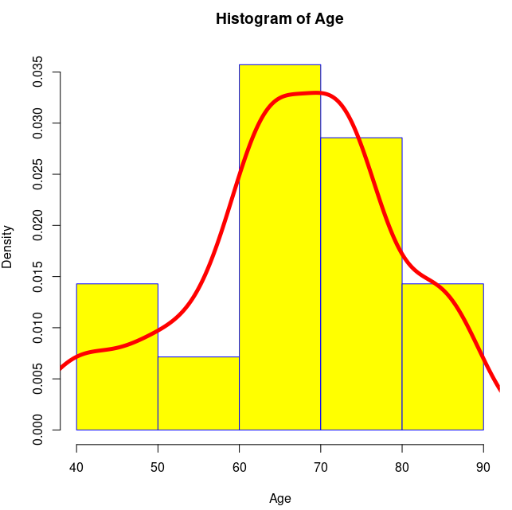
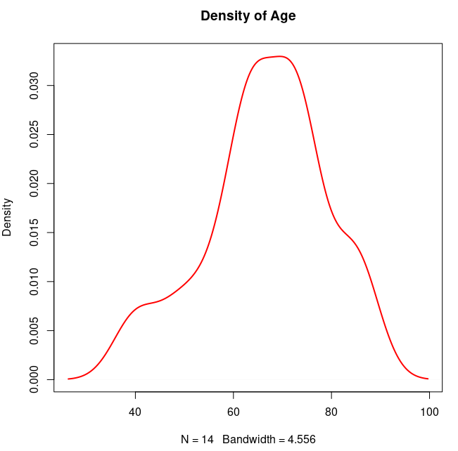
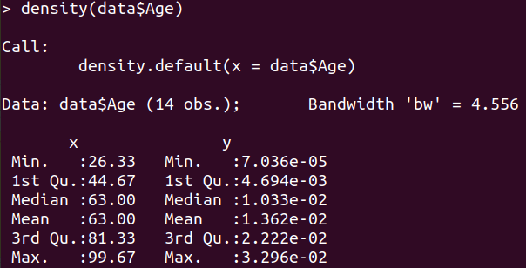
Histogram
hist (var, xlab, ylab, main, xlim, ylim, col, border, prob)
lines (density(var), col, lwd)
hist(data$Age, col = "yellow", main= "Histogram of Age", xlab = "Age", border = "blue", probability = T)
lines(density(data$Age),col="red",lwd=5)
dx <- density(data$Age)
plot(dx, lwd=2, col = "red", main = "Density of Age")

Slide 18
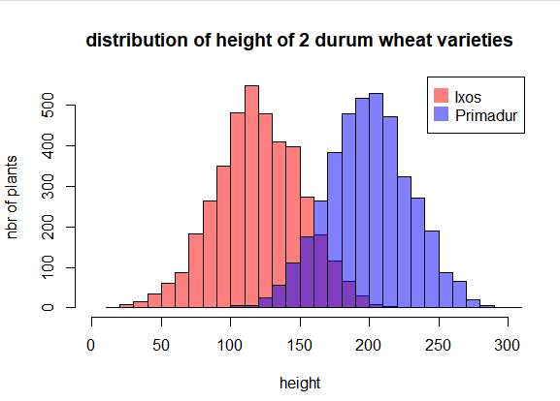
Histogram
#Create data
set.seed(1)
Ixos=rnorm(4000 , 120 , 30)
Primadur=rnorm(4000 , 200 , 30)
# First distribution
hist(Ixos, breaks=30, xlim=c(0,300), col=rgb(1,0,0,0.5), xlab="height",
ylab="nbr of plants", main="distribution of height of 2 durum wheat varieties" )
# Second with add=T to plot on top
hist(Primadur, breaks=30, xlim=c(0,300), col=rgb(0,0,1,0.5), add=T)
# Add legend
legend("topright", legend=c("Ixos","Primadur"), col=c(rgb(1,0,0,0.5),
rgb(0,0,1,0.5)), pt.cex=2, pch=15 )

Slide 19
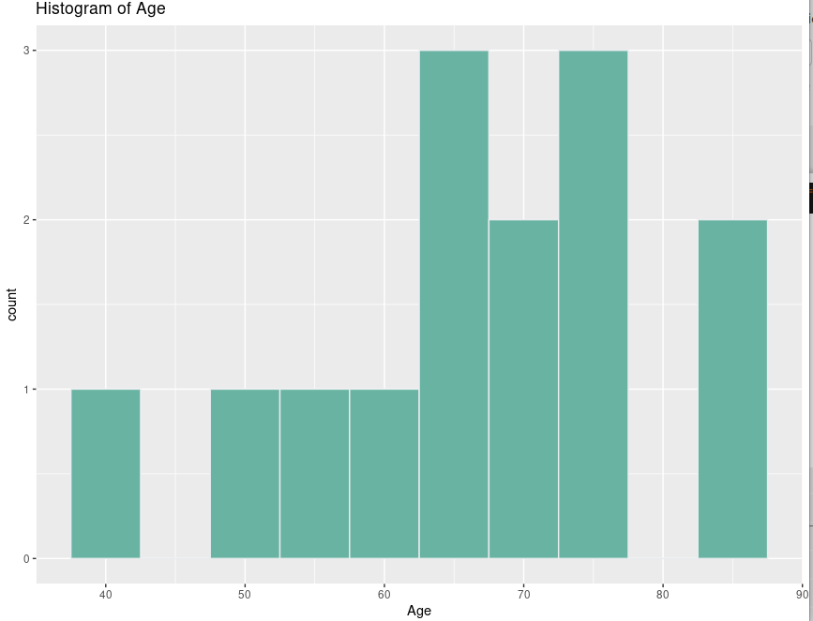
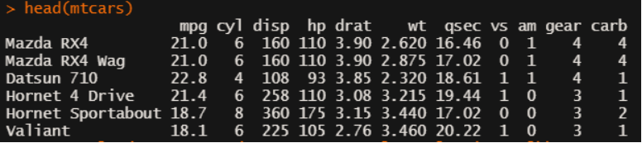
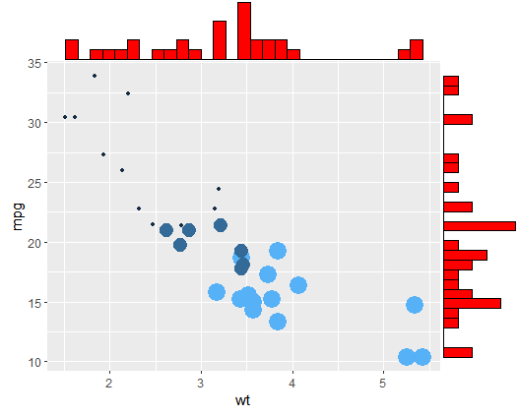
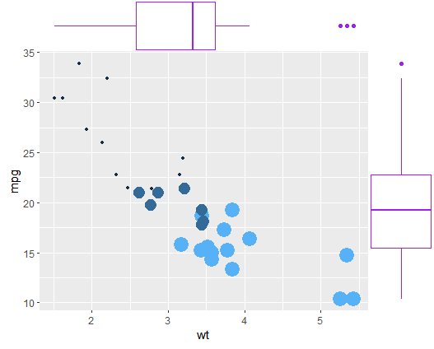
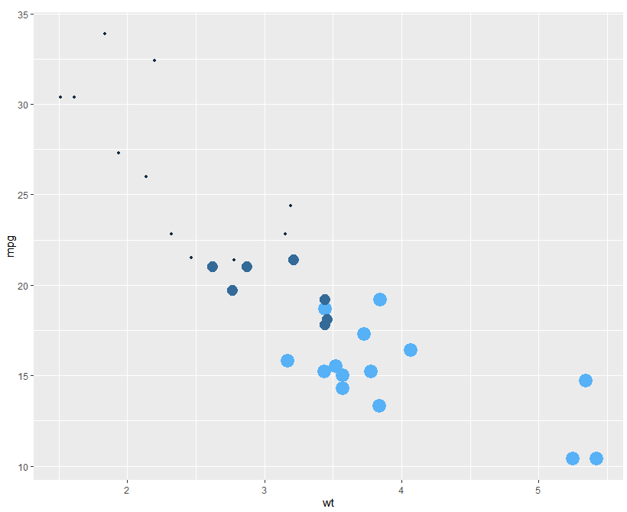
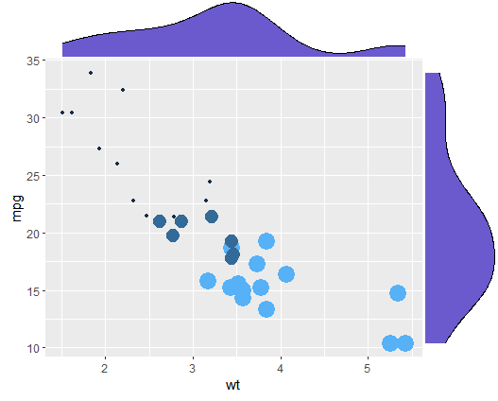
Histogram
ggplot(data,aes(x=Age))+ geom_histogram(binwidth=5, fill="#69b3a2", color="#e9ecef") + ggtitle("Histogram of Age")
# Histogram + scatterplot
library(ggExtra)
p <- ggplot(mtcars, aes(x=wt, y=mpg, color= cyl, size = cyl)) + geom_point() + theme(legend.position = "none")
p1 <- ggMarginal(p, type="histogram", fill="red")
p2 <- ggMarginal(p, type="density", fill="slateblue")
p3 <- ggMarginal(p, type="boxplot", fill="purple")

Slide 20
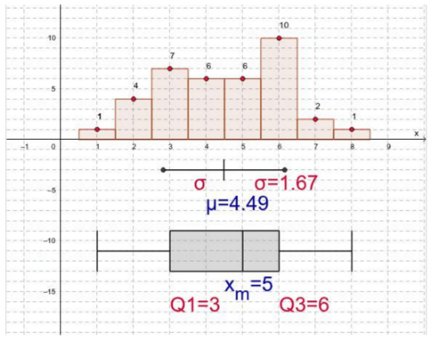
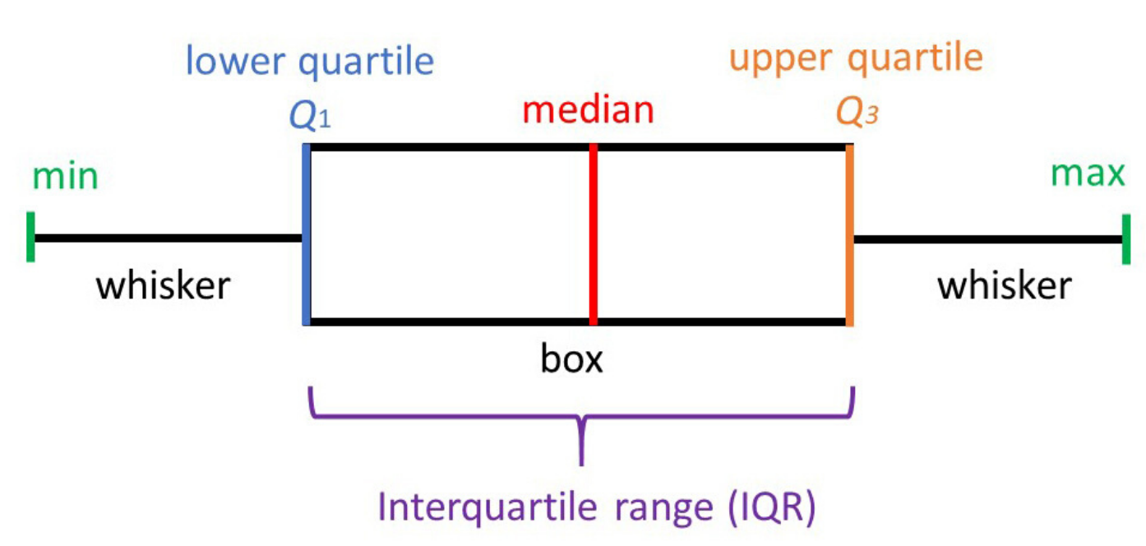
Boxplot
Notes:
Tứ phân vị là đại lượng mô tả sự phân bố và sự phân tán của tập dữ liệu. Số phân tử có 3 giá trị, đó là số phân tử thứ nhất (Q1), thứ nhì (Q2) và thứ ba (Q3)

Slide 21
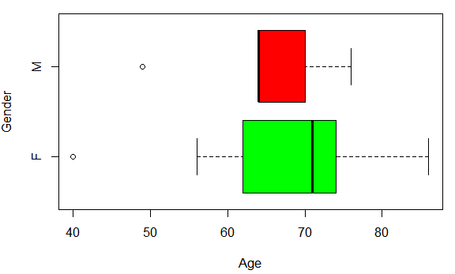
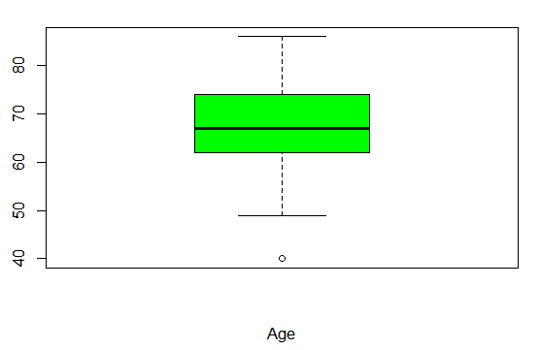
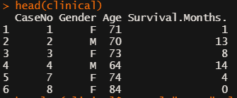
Boxplot
boxplot (var, xlab, ylab, main, border, col, xlim, ylim, horizontal)
boxplot ( var ~ group, xlab, ylab,main, xlim, ylim, border, col, horizontal)
head(clinical)
boxplot(clinical$Age,col="green",xlab="Age")
boxplot(clinical$Age ~ clinical$Gender,col=c("green","red"),xlab = "Age", ylab = "Gender",horizontal = T)
Notes:
Có thể biết phân bố của 1 biến hoặc so sánh ban đầu

Slide 22
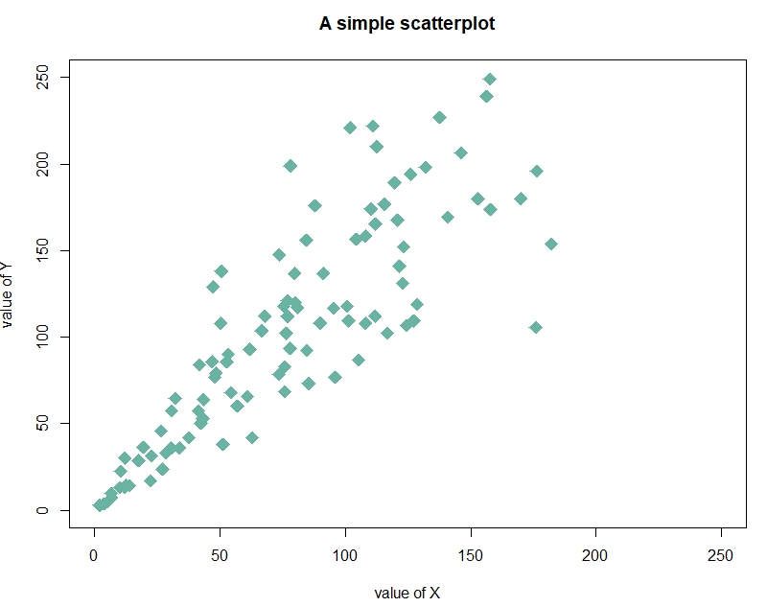
Scatter plot
data = data.frame(
x=seq(1:100) + 0.1*seq(1:100)*sample(c(1:10) , 100 , replace=T),
y=seq(1:100) + 0.2*seq(1:100)*sample(c(1:10) , 100 , replace=T)
)
# Basic scatterplot
plot(data$x, data$y,
xlim=c(0,250) , ylim=c(0,250),
pch=18,
cex=2,
col="#69b3a2",
xlab="value of X", ylab="value of Y",
main="A simple scatterplot"
)
plot (varX ~ varY, xlab, ylab,…)

Slide 23
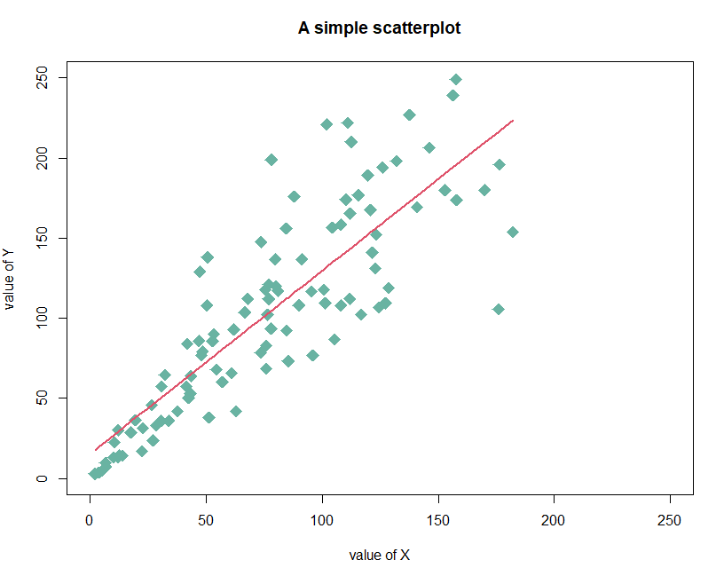
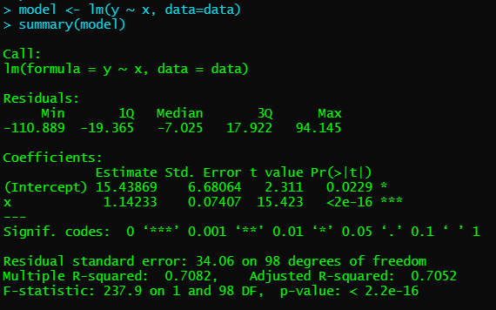
Scatter plot with trend line
plot (varX ~ varY, xlab, ylab,…)
model <- lm(y ~ x, data=data)
summary(model)
Y = 1.14x +15.4

Slide 24
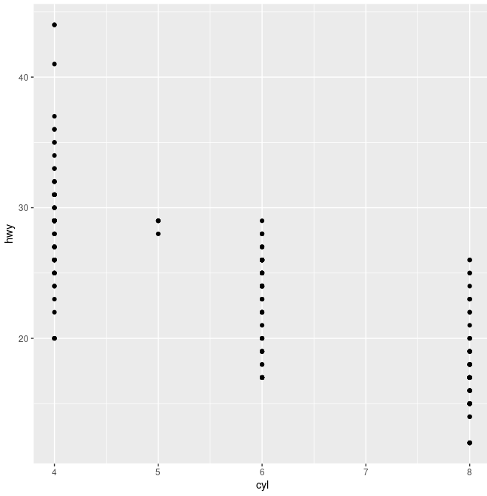
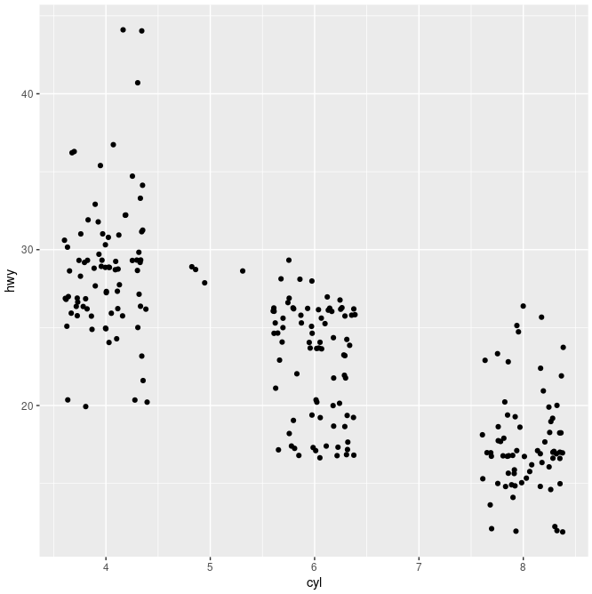
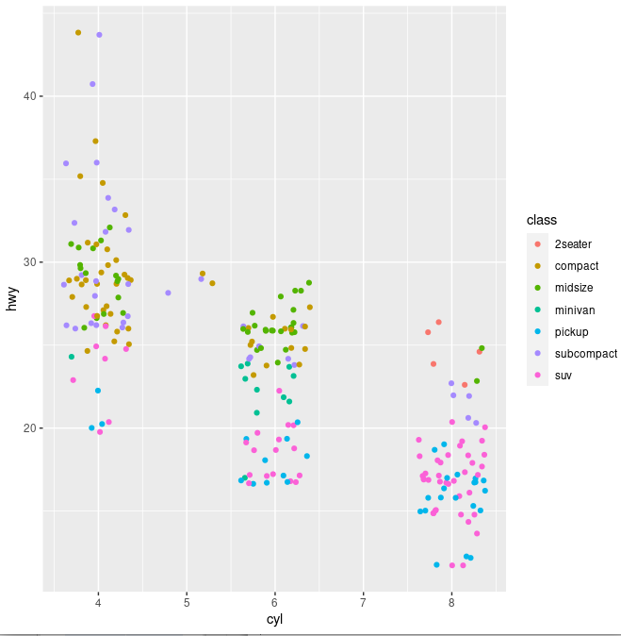
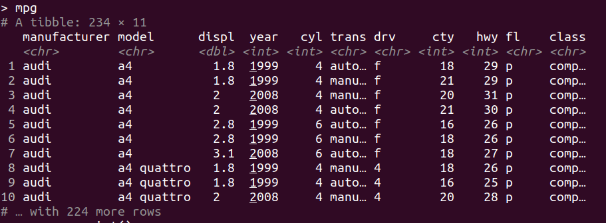
geom_point () - jitter
Typically a scatter plot is better when showing the relationship between two variables which was not important in this specific case. A jitter plot is better to show the distribution of data using a randomized x-axis to disperse the points.
data avaible: mpg in R
p <- ggplot(mpg, aes(cyl, hwy))
p + geom_point()
p + geom_jitter() [p + geom_point(position="jitter")]
p + geom_jitter(aes(colour = class))
Notes:
biểu đồ jitter theo cách này cho phép bạn tách các dấu hoặc chấm thành các cột khác nhau de nhin

Slide 25
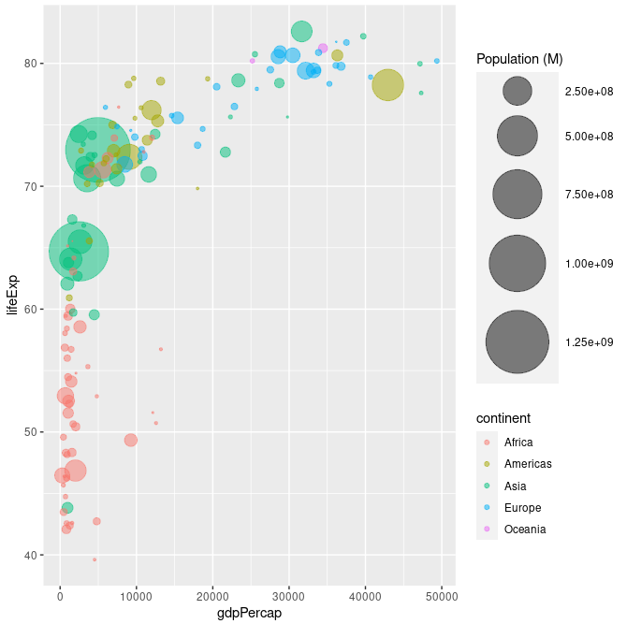
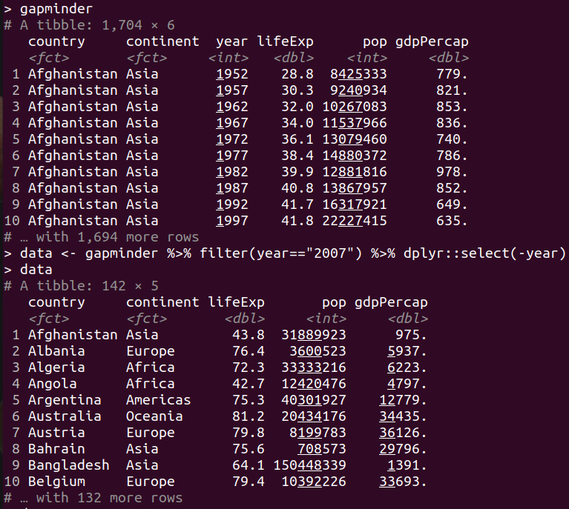
geom_point () - Bubble
library(ggplot2)
library(dplyr)
library(gapminder)
data <- gapminder %>% filter(year=="2007") %>% dplyr::select(-year)
data %>%
arrange(desc(pop)) %>%
mutate(country = factor(country, country)) %>%
ggplot(aes(x=gdpPercap, y=lifeExp, size=pop, color=continent)) +
geom_point(alpha=0.5) +
scale_size(range = c(.1, 24), name="Population (M)")
The first two dimensions for coordinates.
the thrid dimension is for color and the fourth as size.
Notes:
Biểu đồ bong bóng chủ yếu được sử dụng để hiển thị mối quan hệ giữa các biến số và nó có thể trực quan hóa (từ tọa độ, màu sắc và kích thước

Slide 26
HISTOGRAM AND BARPLOT
Histogram | Barplot
Show distributions of variables | Compare variables
Quantitative (numerical) data (continuous) | Categorical data
Not make sense to rearrange | The bars can be rearranged
No space between the columns | Have space between the columns

Slide 27
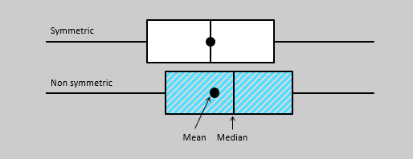
HISTOGRAM AND BOXPLOT
Histogram | Boxplot
probability distribution of a data | Comparing between several data sets. (distribution is symmetric or skewed)
Min, mean, max | Min, median, max and quartile
Although histograms are better in determining the underlying distribution of the data, box plots allow you to compare multiple data sets better than histograms as they are less detailed and take up less space.

